Slide 1



MRBTP: Efficient Multi-Robot Behavior Tree Planning and Collaboration
Session: Robotics (2/4)
Yishuai Cai*, Xinglin Chen*, Zhongxuan Cai†, Yunxin Mao
Minglong Li†, Wenjing Yang, Ji Wang National University of Defense Technology 2025-03-02
Notes:
Good afternoon, everyone. On behalf of the authors, I’m pleased to present their work
MRBTP: Efficient Multi-Robot Behavior Tree Planning and Collaboration

Slide 2
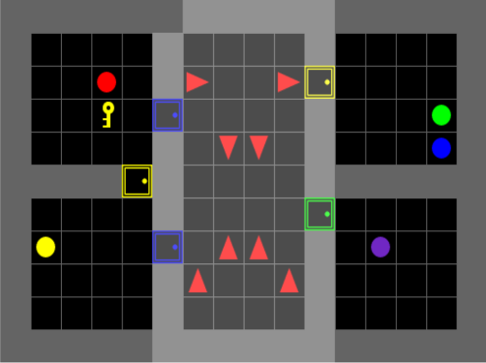


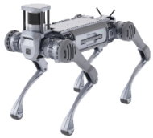
RETURN ON INVESTMENT
Introduction
Multi-robot systems (MRS)
robots with diverse capabilities, improved performance and fault tolerance
requires an efficient and robust control architecture
Behavior Trees (BTs)
a popular control architecture for robot behaviors
modularity, interpretability, reactivity, and robustness
BT in MRS
BT Planning for a Single Robot
Sound and Complete (Proven by BT Expansion^{[1]})
Our Contribution in BT Planning for Multi-Robots
MRBTP: theoretical guarantees of both soundness and completeness
Cross-Tree Expansion and Intention Sharing: Maintain robustness while enhancing execution performance
Optional Plugin (LLM-based subtrees pre-planning): Improves planning and execution efficiency
?
Subtree
Pre-Planning
→
3
Has(S)
?
→
Get(S,R)
Has(F)
Make(F,S)
IsOpen(R)
→
1
Cross-Tree Expansion
In(S,R)
Open(R)
?
Intention
Sharing
→
2
Has(S)
?
?
Has(F)
→
Get(S,R)
IsOpen(R)
→
In(F,P)
Unload(F,P)
In(S,R)
Open(R)
S: Salad F: Fruit P: Package R: Refrigerator
[1] Cai Z, Li M, Huang W, et al. BT Expansion: a sound and complete algorithm for behavior planning of intelligent robots with behavior trees[C] AAAI. 2021.
Notes:
Multi-robot task planning and collaboration are critical challenges in robotics.
Behavior Trees have emerged as a popular control architecture due to their modularity, interpretability, reactivity, and robustness, making them well-suited for both single- and multi-robot systems
While BT planning primarily focuses on single robots, and existing work has theoretically ensured the success of the BT,
multi-robot BT planning remains challenging due to the complexity of coordinating diverse action spaces.
Our work proposes a multi-robot BT Planning framework with theoretical guarantees, enhancing planning and execution efficiency through intention sharing and an optional LLM-based subtree plugin.
----------------------------
1 分钟
Our work propose the MRBTP with theoretical guarantees of both soundness and completeness.
It uses cross-tree expansion to coordinate heterogeneous actions while enhancing robustness and execution efficiency through backup structures and intention sharing. Additionally, it includes an optional plugin, which speeds up planning and improves collaboration pre-planned long-horizon subtrees based on large-language-model inference.

Slide 3
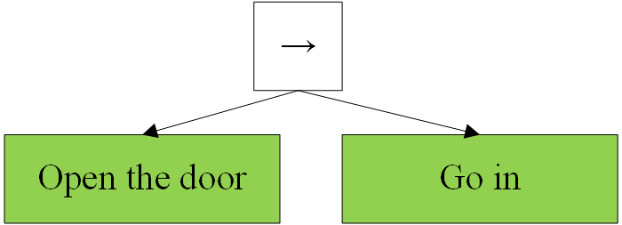
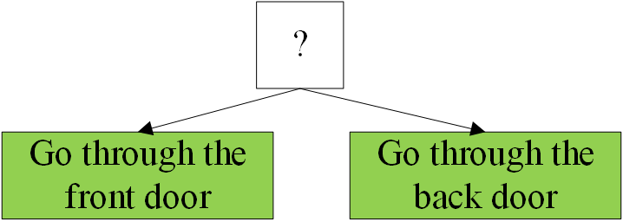
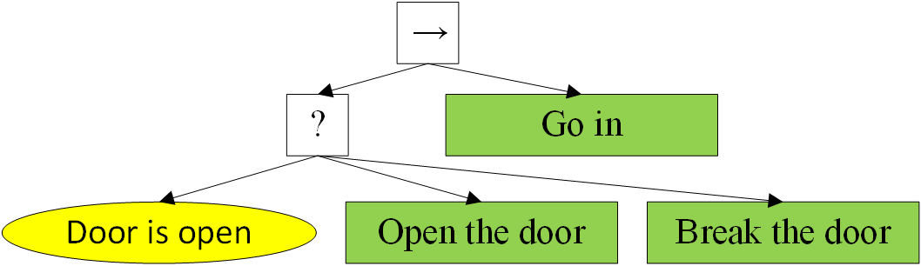
RETURN ON INVESTMENT
Background
Classic Behavior Tree Representation
BT: a directed rooted tree
Root at the top (usually omitted in graphics)
Internal: control-flow nodes
Leaf: condition/action nodes
Returns to the parent: R={Success, Running, Failure}*
Behavior Trees: a running example
Robot entering a room
Sequence nodes
S: All children Succeed
F: One child Fails
R: Others
Fallback nodes
S: One child succeeds
F: All children fail
R: Others
Other control-flow nodes: Parallel nodes and decorator nodes.
The BT can react and adapt to different run-time situations:
Door is open → Directly go in
Door not open → Open the door
Opening fails → Break the door
Someone helps open it → Skip breaking and go in
*Condition nodes only return success or failure.
For more details, we refer the readers to the book Behavior Trees in Robotics and AI: An Introduction, Michele Colledanchise, Petter Ögren, CRC Press.
Notes:
Let’s briefly introduce the classic BT representation.
A BT is a directed rooted tree with a root, internal control flow nodes, and leaf nodes. Control flow nodes manage the logic for triggering their children, while leaf nodes execute actions or check conditions. Each node returns success, running, or failure to its parent.
For example:
Sequence nodes succeed only if all children succeed, like a robot needs to open a door and then go in successfully.
Fallback nodes succeed if at least one child succeeds, like a robot entering through either the front or back door.
Other nodes, like parallel nodes, are less common. For details, see the reference below.

Slide 4
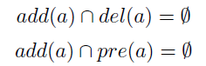
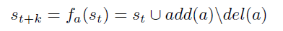
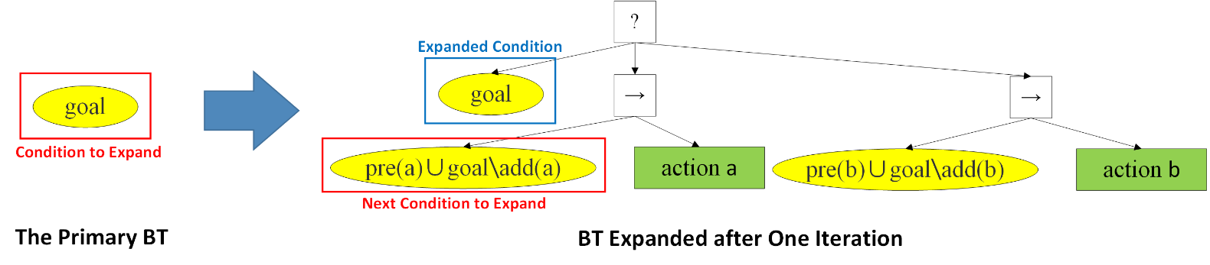
RETURN ON INVESTMENT
Background
BT Expansion^{[1]} : A sound and complete algorithm for single-robot BT planning
STRIPS-style planning states and actions
An action a is a three tuple <pre(a),add(a),del(a)>, consisting of the precondition, add effects and delete effects of the action.
Input & Output
Input: Goal, Initial State, the finite set of actions
Output: Goal-Oriented BT
The one-step expansion
Properties for well-defined actions*
State transition of a BT executing a*
[1] Cai Z, Li M, Huang W, et al. BT expansion: a sound and complete algorithm for behavior planning of intelligent robots with behavior trees[C] AAAI. 2021.
Notes:
Before diving into our work, let’s briefly cover BT Expansion, a sound and complete algorithm for single-robot BT planning.
Our work also define states and actions as in strips-style planning.
An action a is a tuple consisting of the precondition, add effects and delete effects of the action, which will add and delete literals to produce new states. State transitions in BTs can be formally expressed through equations.
BT Expansion constructs BT from an initial state, goal, and action set using one-step expansion—the core algorithm that serves as the foundation for our MRBTP framework for multi-robot systems.

Slide 5
RETURN ON INVESTMENT
Background
BT Expansion^{[1]} : A sound and complete algorithm for single-robot BT planning
Input & Output
Input: Goal, Initial State, the finite set of actions
Output: Goal-Oriented BT
The one-step expansion
Preserve condition c
[1] Cai Z, Li M, Huang W, et al. BT expansion: a sound and complete algorithm for behavior planning of intelligent robots with behavior trees[C] AAAI. 2021.
Notes:
First, it builds the main BT with the goal

Slide 6
RETURN ON INVESTMENT
Background
BT Expansion^{[1]} : A sound and complete algorithm for single-robot BT planning
Input & Output
Input: Goal, Initial State, the finite set of actions
Output: Goal-Oriented BT
The one-step expansion
Preserve condition c
Select actions
[1] Cai Z, Li M, Huang W, et al. BT expansion: a sound and complete algorithm for behavior planning of intelligent robots with behavior trees[C] AAAI. 2021.
Notes:
Then, it performs a backward expansion, selecting candidate actions that may achieve the goal condition

Slide 7
RETURN ON INVESTMENT
Background
BT Expansion^{[1]} : A sound and complete algorithm for single-robot BT planning
Input & Output
Input: Goal, Initial State, the finite set of actions
Output: Goal-Oriented BT
The one-step expansion
Preserve condition c
Select actions
Construct sequence structures
[1] Cai Z, Li M, Huang W, et al. BT expansion: a sound and complete algorithm for behavior planning of intelligent robots with behavior trees[C] AAAI. 2021.
Notes:
Next, it propagates backward to derive the preconditions required for these actions, forming sequential structures.

Slide 8
RETURN ON INVESTMENT
Background
BT Expansion^{[1]} : A sound and complete algorithm for single-robot BT planning
Input & Output
Input: Goal, Initial State, the finite set of actions
Output: Goal-Oriented BT
The one-step expansion
Preserve condition c
Select actions
Construct sequence structures
Link to the top fallback node
[1] Cai Z, Li M, Huang W, et al. BT expansion: a sound and complete algorithm for behavior planning of intelligent robots with behavior trees[C] AAAI. 2021.
Notes:
These structures are then unified under fallback nodes to connect alternative action paths

Slide 9
RETURN ON INVESTMENT
Background
BT Expansion^{[1]} : A sound and complete algorithm for single-robot BT planning
Input & Output
Input: Goal, Initial State, the finite set of actions
Output: Goal-Oriented BT
The one-step expansion -> BT Expansion
Preserve condition c
Select actions
Construct sequence structures
Link to the top fallback node
Repeat 2-4 until the BT can run in Initial State, or all conditions expanded.
BT Expansion
[1] Cai Z, Li M, Huang W, et al. BT expansion: a sound and complete algorithm for behavior planning of intelligent robots with behavior trees[C] AAAI. 2021.
Notes:
After one-step expansion, new condition nodes are added, and the process repeats iteratively until the BT can run from the initial state or fails if no further expansion is possible.

Slide 10
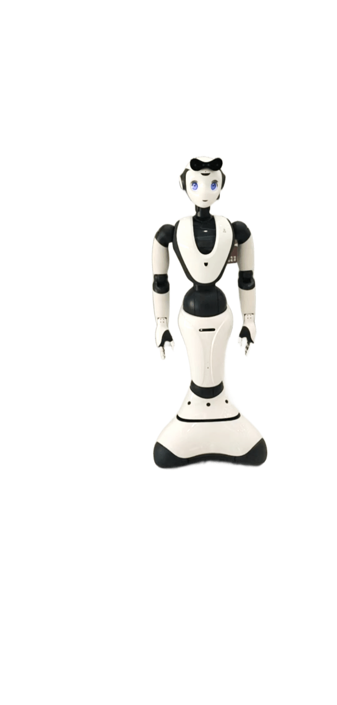
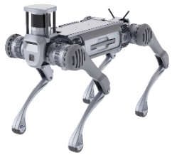
RETURN ON INVESTMENT
Proposed Algorithm: MRBTP
BT Planning for Multi-Robots
Input & Output
Input: Team Goal, Initial State, Finite Action Set for each Robot
Output: Goal-Oriented BT for each Robot
?
→
3
Subtree
Pre-Planning
Challenges
How to coordinating heterogeneous actions across multiple BTs to achieve team goals？
How to enhancing fault tolerance for homogeneous actions without redundant execution？
Has(S)
?
→
Get(S,R)
Has(F)
Make(F,S)
IsOpen(R)
→
1
Cross-Tree Expansion
In(S,R)
Open(R)
?
2
Intention
Sharing
→
Has(S)
?
?
→
Get(S,R)
Has(F)
IsOpen(R)
→
In(F,P)
Unload(F,P)
In(S,R)
Open(R)
S: Salad F: Fruit P: Package R: Refrigerator
Notes:
In multi-robot BT planning, the input expands to include the action spaces of each robot, which may differ significantly or partially overlap , and the output must generate a separate BT for each robot.
However, this raises key challenges: how to coordinate heterogeneous actions across multiple BTs to achieve team goals, and how to enhance fault tolerance for homogeneous actions without redundant execution.

Slide 11
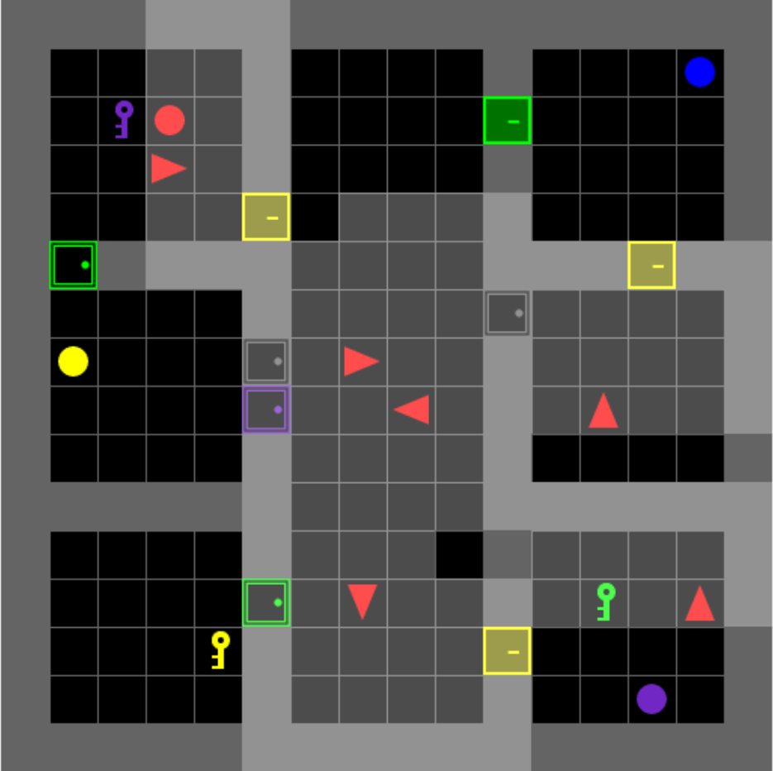
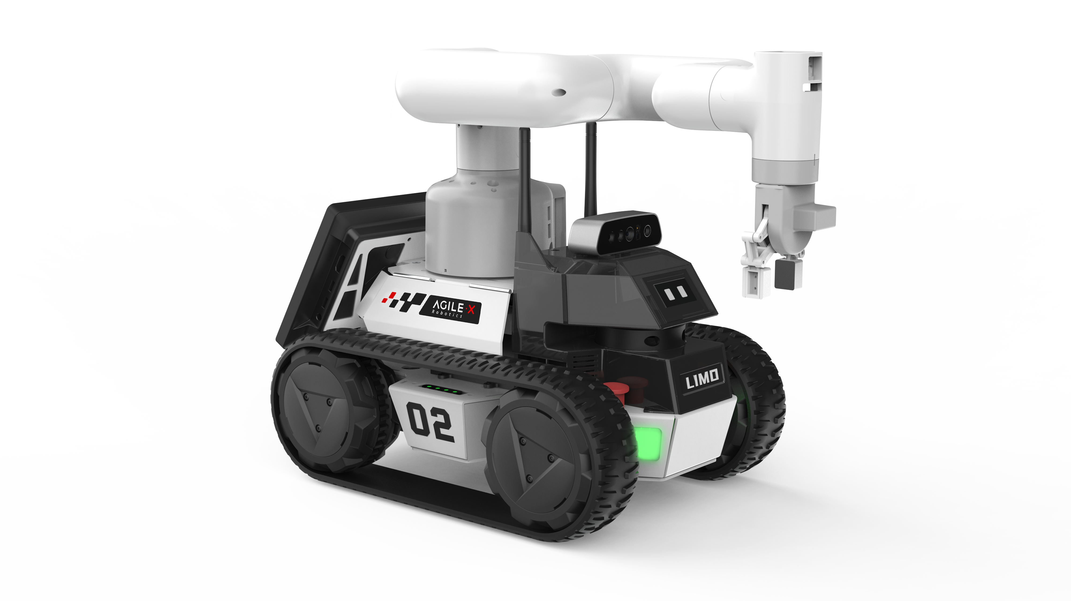
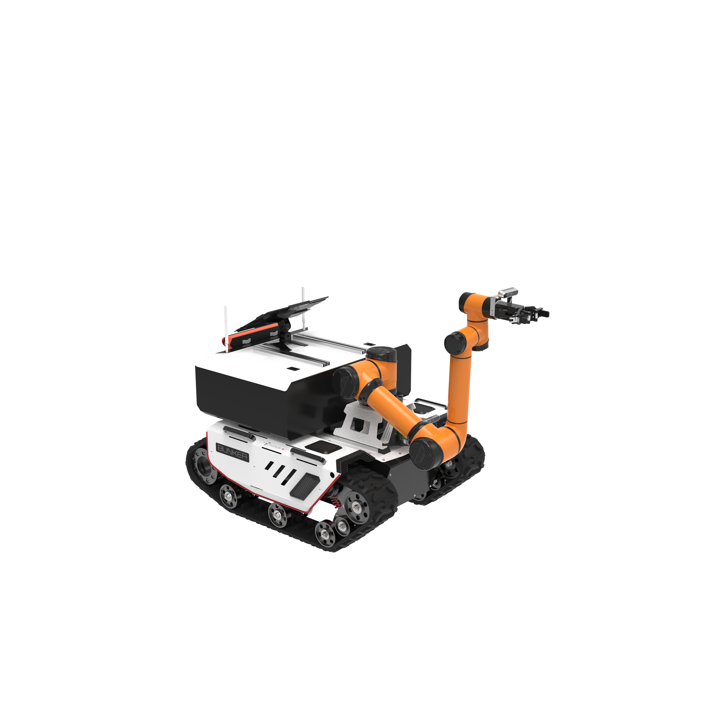
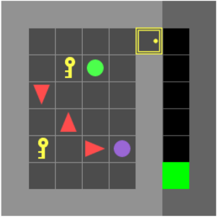



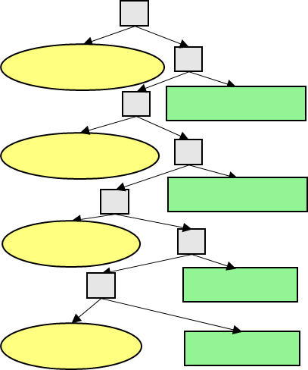
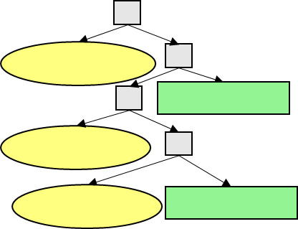

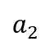
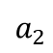
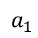
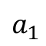
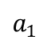
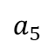
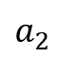
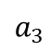
RETURN ON INVESTMENT
Proposed Algorithm: MRBTP
Multi-Robot Behavior Tree Planning
Intention Sharing for Multi-BT Execution
Pending Expansion Conditions
Robot1’s BT
Robot2’s BT
Robot3’s BT
Goal
…
?
?
Waiting for the door to open…
?
→
→
…
In-tree Expansion
?
?
InPlace(Package)
InPlace(Package)
$$a_{1}$$
?
→
→
?
Move(Package)
4
→
?
?
5
$$a_{2}$$
→
→
Near(Package)
→
IsOpen(Door)
InPlace(Package)
?
2
?
Walk(Package)
$$a_{1}$$
?
Cross-tree Expansion
IsClose(Door)
Open(Door)
3
→
?
IsOpen(Door)
→
Send Intention
$$a_{3}$$
→
→
→
1
IsOpen
(Door)
Send
Intention
IsClose(Door)
Open(Door)
$$a_{2}$$
?
No Expansion
?
→
→
Intention
Queue
Open(Door)
Walk(Package)
$$a_{5}$$
$$a_{1}$$
$$a_{2}$$
Optional Plugin: Subtree Pre-Planning
Subtree
Pre-Planning
Walk
(self, pie)
RightGrab
(self, pie)
Walk
(self, table)
RightPut
(self, pie, table)
Robot1
Walk
(self,stove)
Open
(self, stove)
Task-Related
Action Sequences
Subtree
Robot2 …
LLM
Notes:
Our framework consists of three components: Multi-Robot BT Planning for generating coordinated BTs, Intention Sharing to enhance collaboration and fault tolerance, and an Optional Plugin for subtree pre-planning to improve efficiency and scalability.

Slide 12
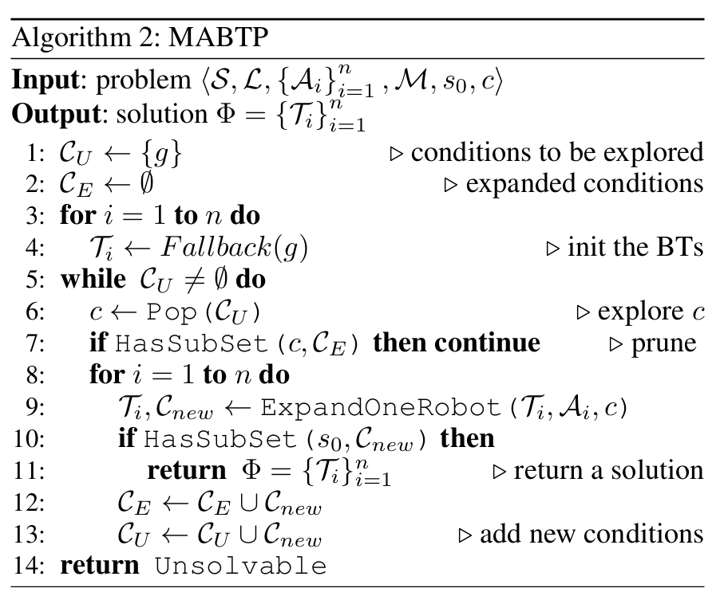
RETURN ON INVESTMENT
Proposed Algorithm: MRBTP
Goal
InRoom(P)
Multi-Robot Behavior Tree Planning
Preserve condition g
?
Move(P)
InRoom(P)
Open(Door)
?
Open(Door)
InRoom(P)
Notes:
First, each robot retains its goal condition node.

Slide 13
RETURN ON INVESTMENT
Proposed Algorithm: MRBTP
Goal
InRoom(P)
IsOpen(Door)
Multi-Robot Behavior Tree Planning
Preserve condition g
One-step expansion of each robot’s BT
?
Move(P)
InRoom(P)
→
Open(Door)
IsOpen(Door)
Move(P)
In-Tree Expansion
?
Open(Door)
InRoom(P)
Notes:
Then, one-step expansion is performed for each robot
Note that the one-step expansion is divided into in-tree expansion and cross-tree expansion.

Slide 14
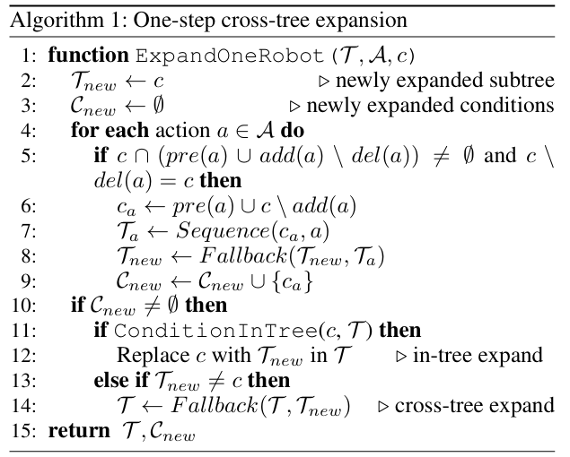
RETURN ON INVESTMENT
Proposed Algorithm: MRBTP
Goal
IsOpen(Door)
IsClose(Door)
Multi-Robot Behavior Tree Planning
Preserve condition g
One-step expansion of each robot’s BT
In-Tree Expansion
Cross-Tree Expansion
?
Move(P)
InRoom(P)
→
Open(Door)
?
Move(P)
IsOpen(Door)
→
IsClose(Door)
Open(Door)
In-Tree Expansion
?
Open(Door)
InRoom(P)
Notes:
In-tree expansion occurs when the condition node is within the robot’s own BT, allowing it to expand using the single-robot algorithm.

Slide 15
RETURN ON INVESTMENT
Proposed Algorithm: MRBTP
Goal
IsOpen(Door)
IsClose(Door)
Multi-Robot Behavior Tree Planning
Preserve condition g
One-step expansion of each robot’s BT
In-Tree Expansion
Cross-Tree Expansion
?
Move(P)
InRoom(P)
→
Open(Door)
?
Move(P)
IsOpen(Door)
→
IsClose(Door)
Open(Door)
In-Tree Expansion
?
Cross-Tree Expansion
InRoom(P)
?
Open(Door)
IsOpen(Door)
→
IsClose(Door)
Open(Door)
Notes:
Cross-tree expansion happens when the condition node is outside the robot’s BT, requiring the robot to add the expanded subtree to its BT by connecting it to the top-level fallback node
The process iterates until all conditions resolve to the initial state or no further expansion is possible.

Slide 16

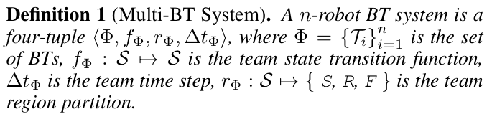
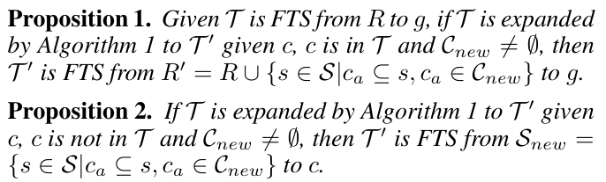
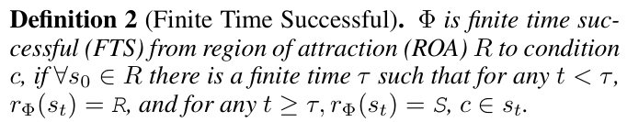
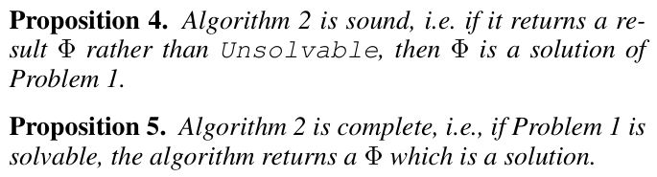
RETURN ON INVESTMENT
Proposed Algorithm: MRBTP
Multi-Robot Behavior Tree Planning
Preserve condition g
One-step expansion of each robot’s BT
In-Tree Expansion
Cross-Tree Expansion
Proof of Soundness and Completeness
Notes:
Additionally, this work leverages theoretical foundations from BT expansion, such as BT attraction domains and finite-time success guarantees, to prove its soundness and completeness.

Slide 17
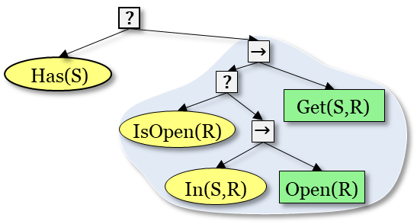
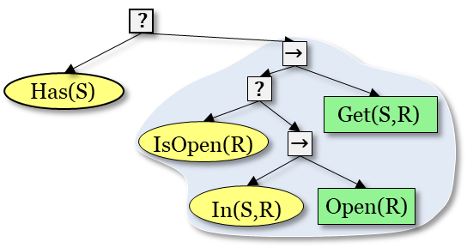
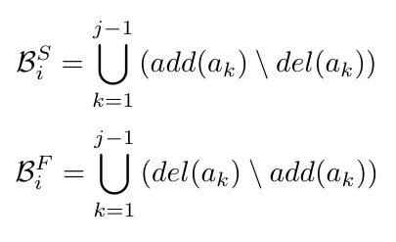



RETURN ON INVESTMENT
Proposed Algorithm: MRBTP
Intention Sharing for Multi-BT Execution
Enhancing fault tolerance for homogeneous actions without redundant execution
Intention Queue
Belief Success Space: The set of states a robot anticipates will be satisfied
Belief Failure Space: The set of states a robot anticipates will not be satisfied
Parallelism and Blocking
Robot1’s BT
Robot2’s BT
Robot3’s BT
?
?
Waiting for the door to open…
?
→
→
…
?
InPlace(Package)
InPlace(Package)
→
?
Move(Package)
4
?
5
→
Near(Package)
→
IsOpen(Door)
InPlace(Package)
2
?
Walk(Package)
IsClose(Door)
Open(Door)
3
IsOpen(Door)
→
Send Intention
1
IsOpen
(Door)
Send
Intention
IsClose(Door)
Open(Door)
Robot i's Belief Space
(j: Index in the Queue)
Intention
Queue
Open(Door)
Walk(Package)
Notes:
In MRBTP planning, similar actions across robots create backup structures, enabling task takeover if a robot fails, but they can also lead to redundant execution. To address this, we introduce multi-BT intention sharing through communication.
Each robot maintains an intention queue tracking others' actions, which helps compute its Belief Success Space and Belief Failure Space based on its position and preceding robots' intentions.
Using the belief space for BT decision-making improves parallelism and reduces blocking during execution.
---
这页1分钟

Slide 18
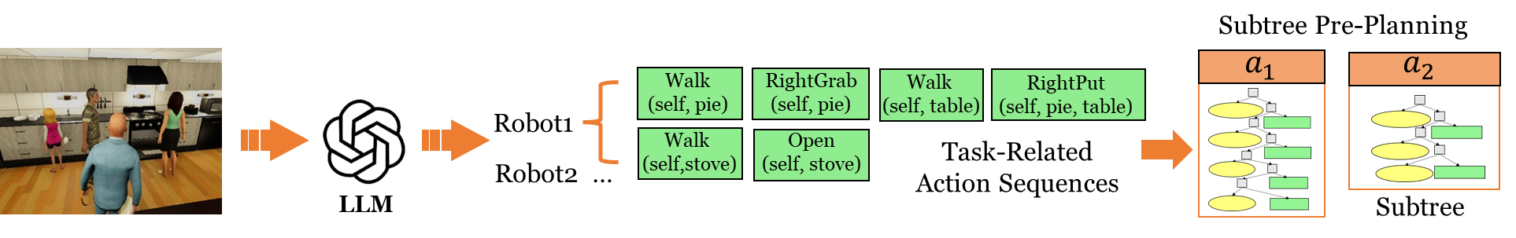
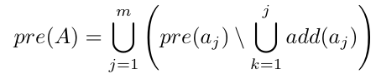
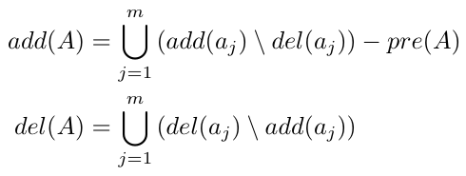
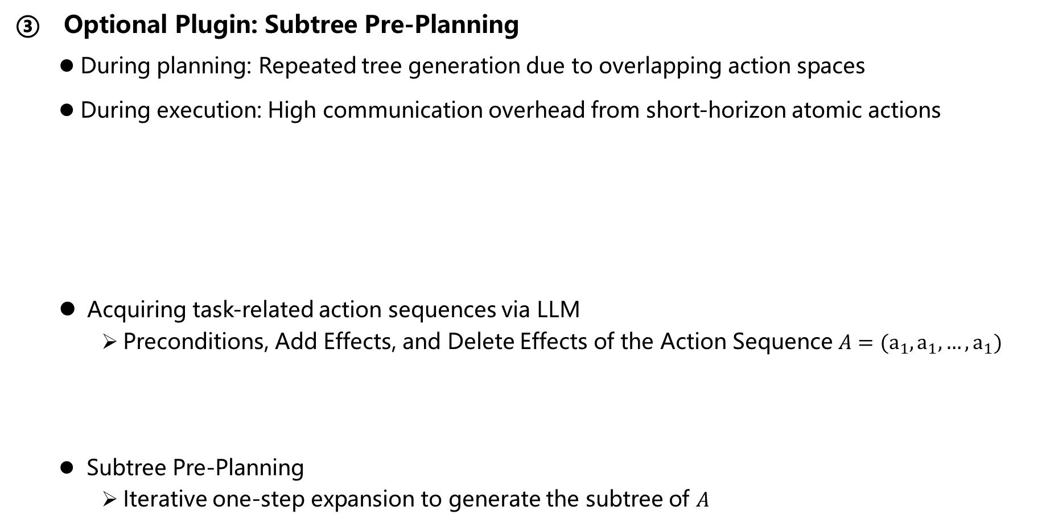
RETURN ON INVESTMENT
Proposed Algorithm: MRBTP
Optional Plugin: Subtree Pre-Planning
During planning: Repeated tree generation due to overlapping action spaces
During execution: High communication overhead from short-horizon atomic actions
Acquiring task-related action sequences via LLM
Preconditions, Add Effects, and Delete Effects of the Action Sequence $A=(a_{1},a_{1},…,a_{1})$
Subtree Pre-Planning
Iterative one-step expansion to generate the subtree of $A$
Notes:
While MRBTP with intention sharing works well, there is still room for improvement. We notice repeated tree generation during planning (due to overlapping action spaces) and high communication overhead during execution (from short-horizon atomic actions).
To resolve these, we propose Subtree Pre-Planning — an optional plugin leveraging LLMs to extract task-specific action sequences. These sequences are pre-planned into modular subtrees, with their preconditions, add/delete effects dynamically recalculated to ensure semantic consistency.
Thus, during planning, computational efficiency is enhanced through prioritized subtree reuse and during execution, communication costs are minimized by predominantly sharing subtree-level intentions as opposed to atomic actions, collectively improving system efficiency.
In this context, the Subtree Pre-Planning algorithm still relies on the iterative one-step in-tree expansion method.

Slide 19
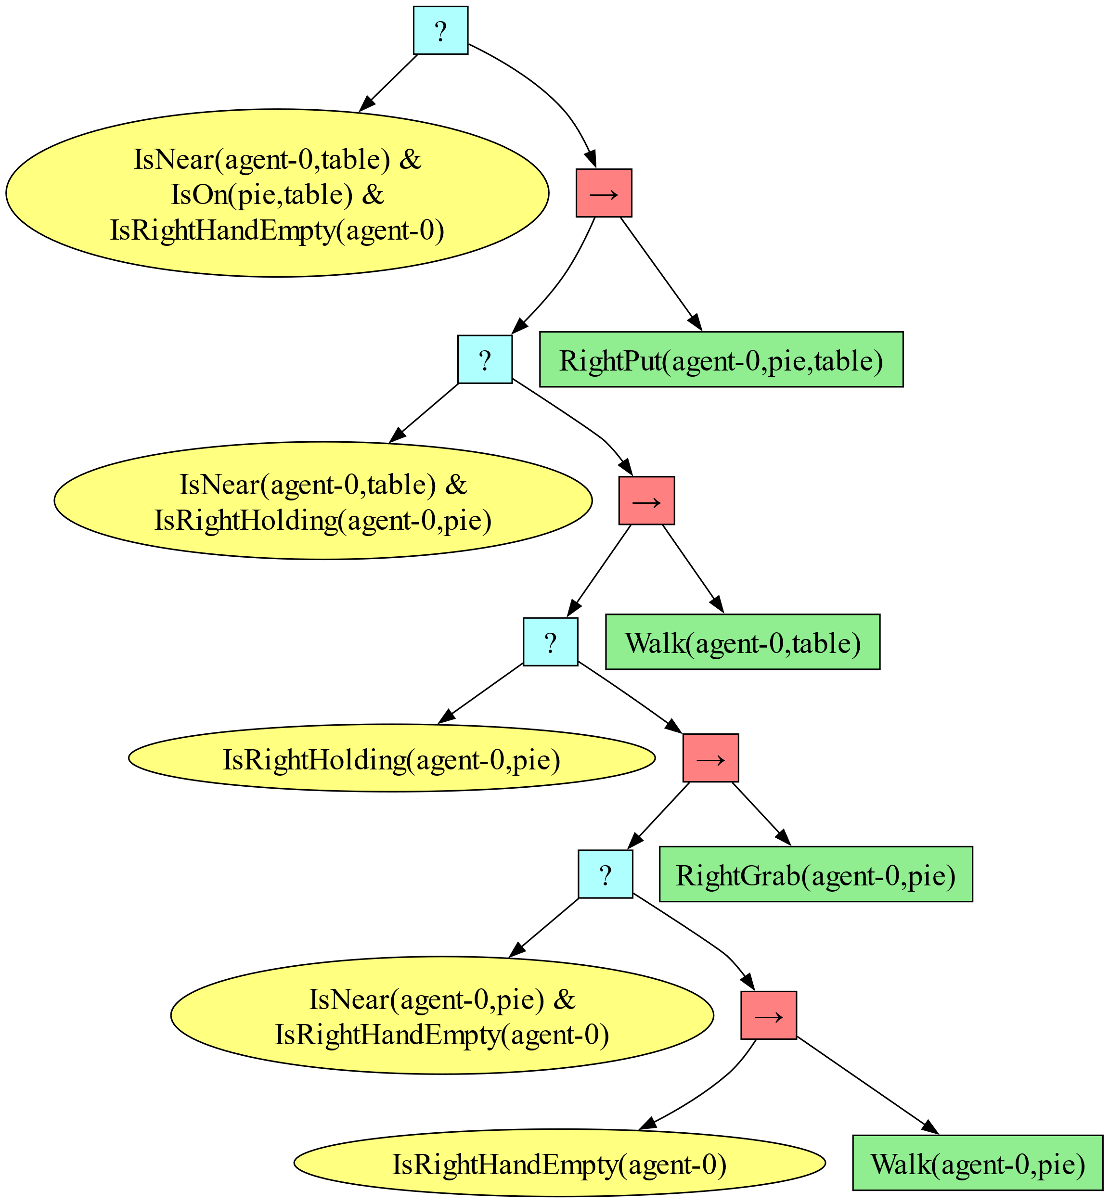

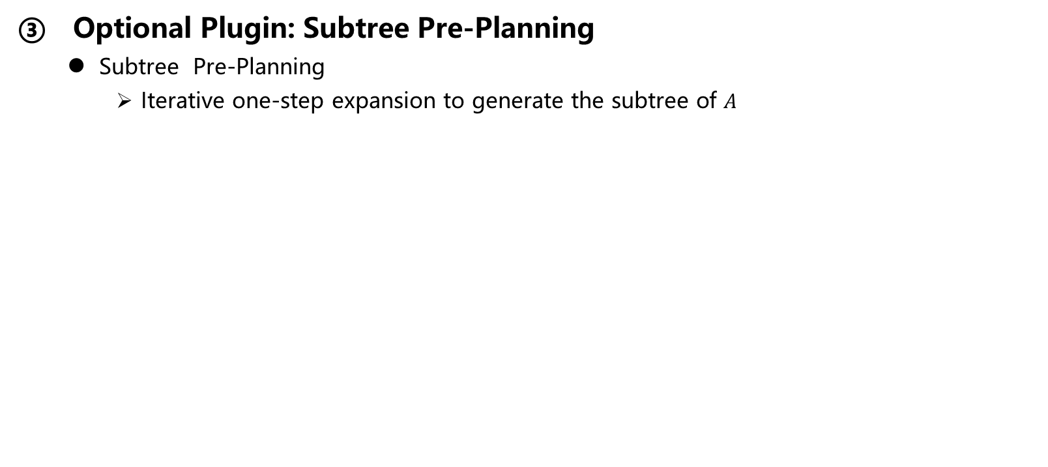
RETURN ON INVESTMENT
Proposed Algorithm: MRBTP
Optional Plugin: Subtree Pre-Planning
Subtree Pre-Planning
Iterative one-step expansion to generate the subtree of $A$
Walk
(self, pie)
RightGrab
(self, pie)
Walk
(self, table)
RightPut
(self, pie, table)
Task-Related Action Sequences
Iterative
One-Step
Expansion
LLM
Robot1
Notes:
Specifically, each layer only expands one node at a time based on the reverse order of the action sequences from the LLM. And It calculates the dynamic preconditions for these actions and then connects the conditions with the actions in a sequence.

Slide 20
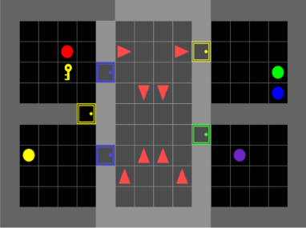

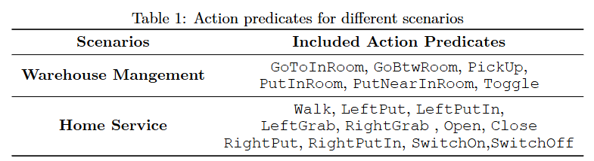
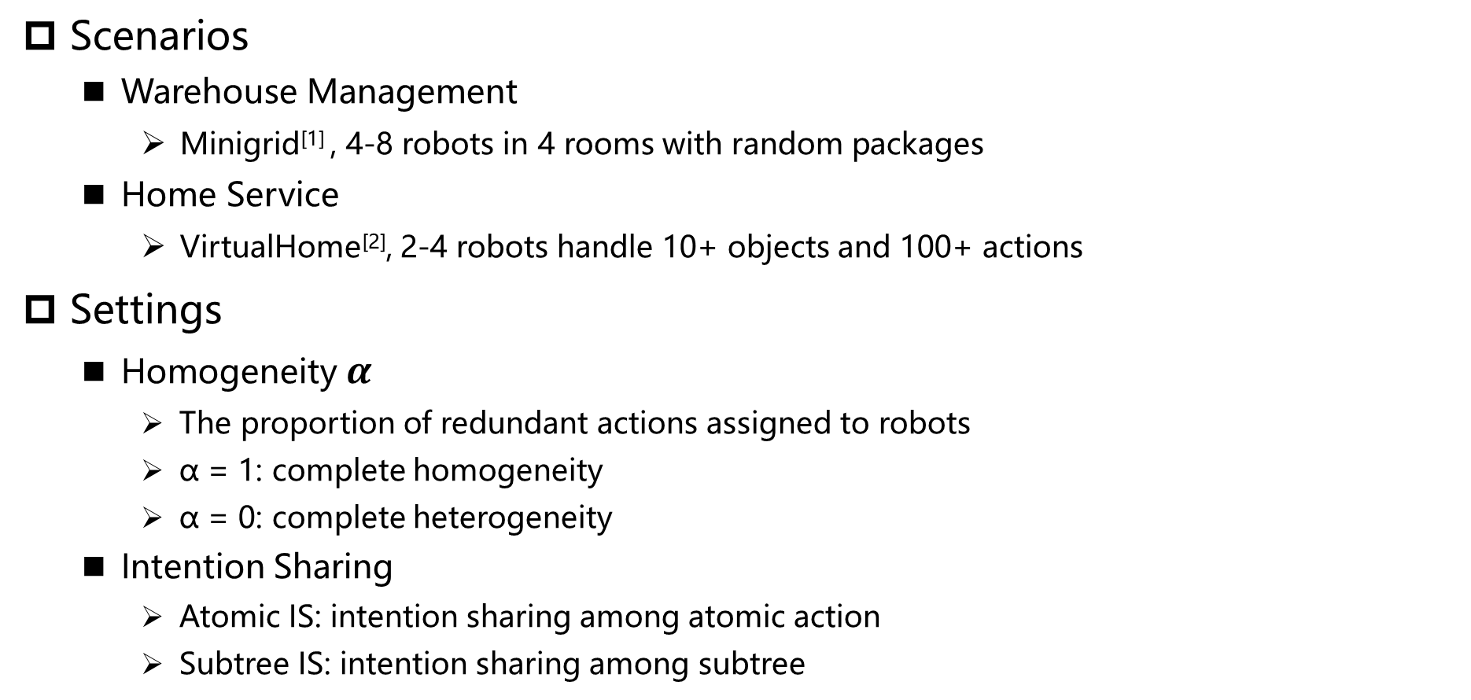
RETURN ON INVESTMENT
Evaluation
Scenarios
Warehouse Management
Minigrid^{[1]} , 4-8 robots in 4 rooms with random packages
Home Service
VirtualHome^{[2]}, 2-4 robots handle 10+ objects and 100+ actions
Settings
Homogeneity $α$
The proportion of redundant actions assigned to robots
α = 1: complete homogeneity
α = 0: complete heterogeneity
Intention Sharing
Atomic IS: intention sharing among atomic action
Subtree IS: intention sharing among subtree
Notes:
We evaluate our method in two simulation scenarios with distinct complexity levels: warehouse management and home service.
Our analysis investigates two key variables: Homogeneity (α) — the proportion of redundant actions assigned to robots, where α=1 indicates full homogeneity and α=0 complete heterogeneity — and Intention Sharing modes, covering both atomic action-level and subtree-level modular coordination.
----
后面共计3分钟

Slide 21
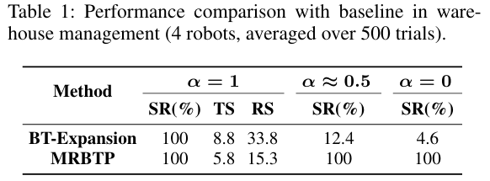
RETURN ON INVESTMENT
Evaluation
Evaluation Metrics
Success Rate (SR): Task success rate across trials
Team Steps (TS): Total steps for all robots to complete tasks in parallel
Total Robot Steps (RS): Sum of steps taken by each robot independently
Performance Comparison
MRBTP achieves a 100% success rate across all settings due to its cross-tree expansion
MRBTP outperforms BT-Expansion in execution efficiency due to intention sharing
Notes:
We used BT-Expansion as our baseline, where each robot independently plans backward toward the team goal without cross-tree expansion or intention sharing.
The results demonstrate that MRBTP achieves a 100% success rate across all settings and also delivers better execution efficiency while ensuring success.

Slide 22
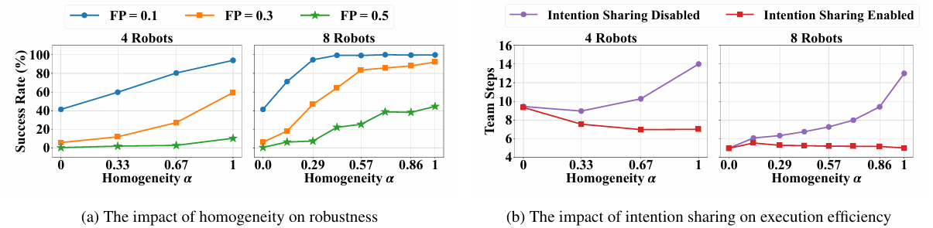
RETURN ON INVESTMENT
Evaluation
Robustness
Action Failure Probability (FP): The probability that a robot fails to execute an action
Robustness improves with higher homogeneity and more robots
Impact of Intention Sharing on Execution Efficiency
Intention sharing reduces team steps and maintains superior execution efficiency
In fully heterogeneous scenarios, intention sharing achieves the greatest efficiency gains
Notes:
We tested the system's robustness by introducing random action failures in some robots. The results show that it can still complete tasks even with failures, and its robustness improves when the robots are more similar or the team size increases.
Additionally, intention sharing significantly enhances execution efficiency, reducing team steps and excelling in fully heterogeneous settings.

Slide 23
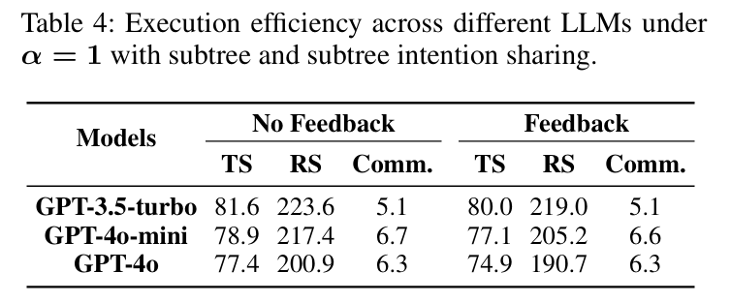
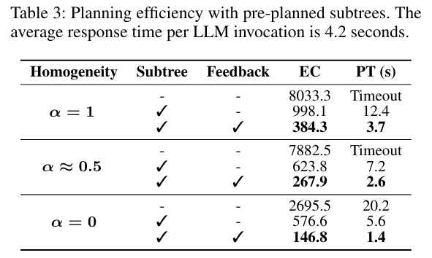
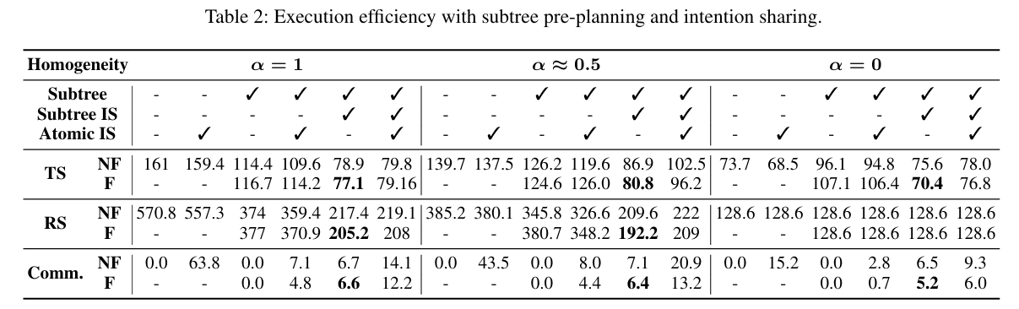
RETURN ON INVESTMENT
Evaluation
Impact of Task-Specific Subtree Pre-Planning
Subtree pre-planning and reuse significantly reduces BTs planning time
Intention sharing within subtrees improves execution efficiency while minimizing communication overhead
LLMs and Feedback
Feedback (F) and No Feedback (NF)
Feedback: grammar errors, Insufficient/incoherent action sequences,
Feedback effectively enhances both planning and execution efficiency
It becomes more effective as the reasoning ability of LLMs improves
Notes:
We also tested the LLM-based subtree plugin and found that it cuts down planning time and communication overhead by reusing pre-planned subtrees. On top of that, the feedback from LLMs boosts both planning and execution efficiency. Interestingly, the better the reasoning ability of the LLM, the more suitable and effective the subtree pre-planning becomes.

Slide 24
RETURN ON INVESTMENT
Summary
Conclusion
MRBTP, the first sound and complete algorithm for solving the multi-robot BT planning problem
MRBTP uses cross-tree expansion to coordinate heterogeneous actions and enhances robustness and execution efficiency with backup structures and intention sharing
Optional LLMs plugin speeds up planning and improves collaboration with pre-planned long-horizon subtrees
Future Work
Real-time deadlock detection and resolution in BT execution
Efficient large-scale BT communication, coordination, and emergent intelligence
Planning under uncertainty and periodic tasks
Notes:
Finally, we summarize our work.
Our work proposes a multi-robot BT Planning framework with theoretical guarantees, enhancing planning and execution efficiency through intention sharing and an optional LLM-based subtree plugin.
Building on MRBTP's foundation, future work will focus on real-time deadlock detection and resolution in BT execution, efficient large-scale BT communication and coordination, as well as planning under uncertainty and for periodic tasks.
----------------------------
We propose MRBTP, the first sound and complete algorithm for solving the multi-robot BT planning problem. It uses cross-tree expansion to coordinate heterogeneous actions and enhances robustness and execution efficiency with backup structures and intention sharing. Additionally, the Optional LLMs plugin speeds up planning and improves collaboration with pre-planned long-horizon subtrees.

Slide 25
MRBTP: Efficient Multi-Robot Behavior Tree Planning and Collaboration
Thank you!
Q & A
Email: dids_ei@163.com
Code: https://github.com/DIDS-EI/MRBTP
Notes:
That’s all of our presentation. Thanks for your listening.
------------------------------------------
Arxivz 网页？二维码？
把 PPT 挂到网页上去

